Slide 1
ABSTRACTIVE TEXT SUMMARIZATION
BIAS and FAIRNESS
Krupa Shah, Rishabh Anand, Abhinav Mishra

Slide 2
INTRODUCTION
The power of summarization
The challenge: Bias and controversy
Identifying and addressing bias
A world of responsible AI
Notes:
The Power of Summarization:
Summarization is a game-changer, condensing information for quick understanding. Imagine going through a document 10 pages long and having to generate a summary of two sentences. AI can achieve this in just a few seconds.
It's everywhere: news, articles, research. But the question is that is it always fair?
Unveiling the Challenge: Bias and Controversy:
Bias sneaks into algorithms, impacting how information is presented.
Controversial content poses risks—distorting the facts, shaping opinions.
Our Mission: Fair and Unbiased Summaries:
We're on a mission to make sure summaries are fair, not favoring any side and generate unbiased content and display just the facts.
How We Do It: Identifying and Addressing Bias:
We're digging into algorithms, spotting biases that could skew information.
Controversial topics? We're not avoiding them; we're facing them head-on.
Why it Matters: A World of Responsible AI:
In a world where robots are getting smarter, we need them to be fair and responsible too..
Responsible AI isn't just a buzzword. It's about creating tech that respects all sides of the story.

Slide 3
Walking through our Project
01.
02.
03.
Data collection
Eda & text cleaning
Sentiment Analysis
04.
05.
06.
Emotions & Sarcasm detection
Bias words detection
summarization
Collection of news articles
Cleaning and visualising data
Checking the sentiments of the news articles
To better understand the context of the text
Removing the bias words
Summarising the unbiased data

Slide 4
How bias can affect summarization
Can be found in both human-written as well as AI generated summaries.
Affect the perspective the audience highly.
Important to generate factual information.
Gender and racial bias can lead to inequality and unfair news.
Notes:
Media bias is an important issue for both human-written as well as AI generated summaries, because both approaches can contain biased opinions and content. Human content writers tend to add their opinion while writing news whereas AI models can carry the bias from the dataset it has been trained on.
News bias can significantly impact the audience by shaping their perspectives and influencing their understanding of events. When news sources display bias, whether intentional or unintentional, it can lead to a skewed portrayal of information. This may result in individuals forming opinions based on incomplete or biased views, potentially affecting their beliefs and decision-making.
It's crucial for the audience to be aware of potential biases in news reporting, seek diverse sources, and critically evaluate information to form a more balanced and informed understanding of the world around them. It is important to eliminate the bias to give neutral and factual content to the audience and for them to have their own perspective and build an opinion.
Unfair summaries leading to racial or gender bias can promote certain racial or gender groups in a negative light and support wrong stereotypes.

Slide 5
01.
Data collection
News Articles

Slide 6
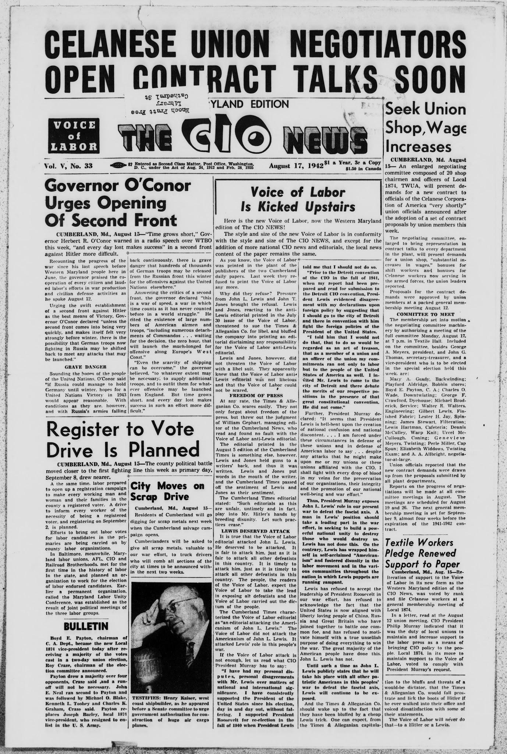
Summarization data
The data for our study originated from two primary sources: the CNN News article dataset and
web-scraped tweets from Twitter.
We used different datasets for training sarcasm detection model and bias words classification.

Slide 7

Cnn news dataset
Data snippet
Dataset comprises over 300,000 rows and includes articles spanning the years
2017 to 2022
Data sourced from Kaggle. For accessing the data, click here

Slide 8
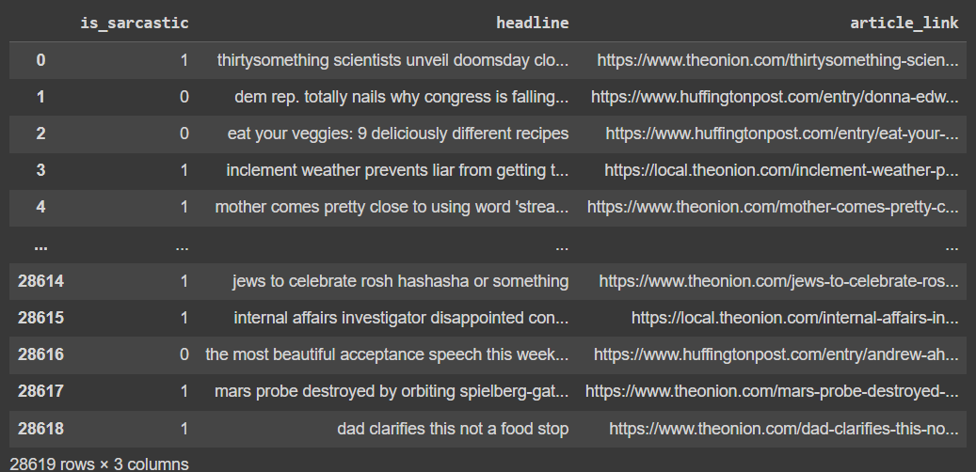
Sarcasm detection Dataset
Data snippet
Compiled from two distinct news websites. TheOnion & HuffPost.

Slide 9
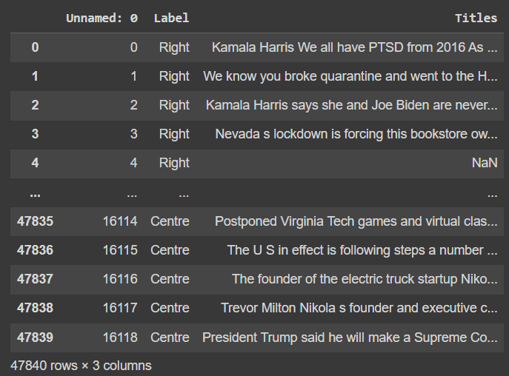
Media bias Dataset
Data snippet
Dataset is web scraped from Twitter comprising 47840 rows and 3 columns

Slide 10

Text cleaning
Converted to
Lower Case
HTML tags
removed
Punctuations
removed
Expand contractions
Special Characters
removed
Numbers
removed
Tokenization
Stop words
removed
Lemmatization
Joining tokens back into CLEAN TEXT
Short words
Removed

Slide 11
02.
Eda
Text cleaning and visualization

Slide 12
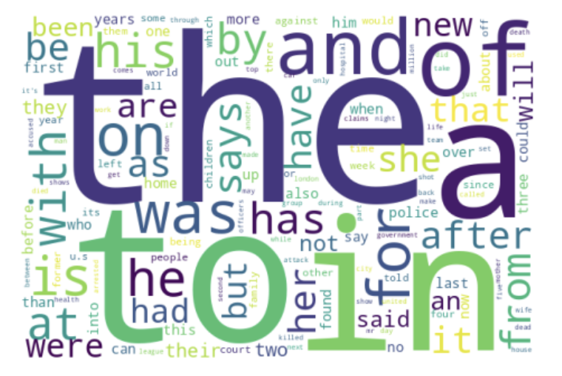
Text before cleaning

Slide 13
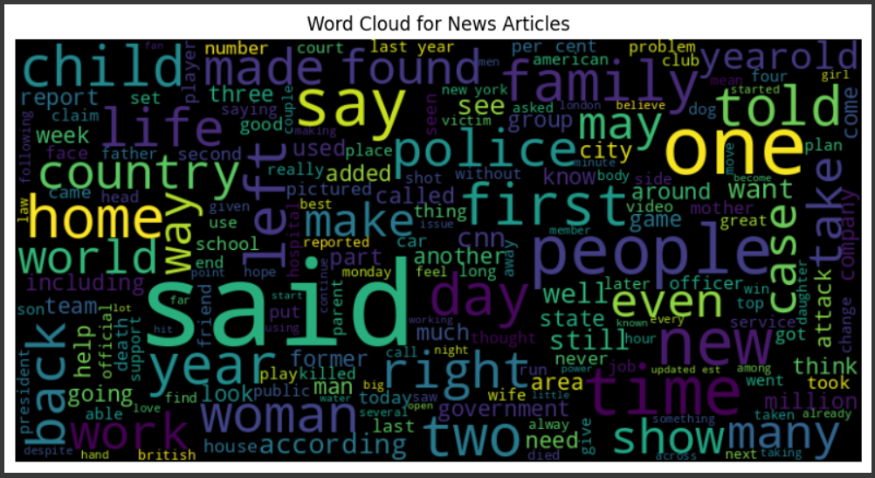
Market size
text after cleaning

Slide 14
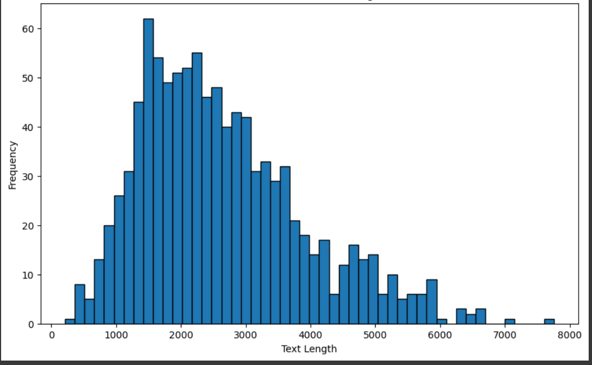
Distribution of text length

Slide 15
Highlight Biased words

Slide 16
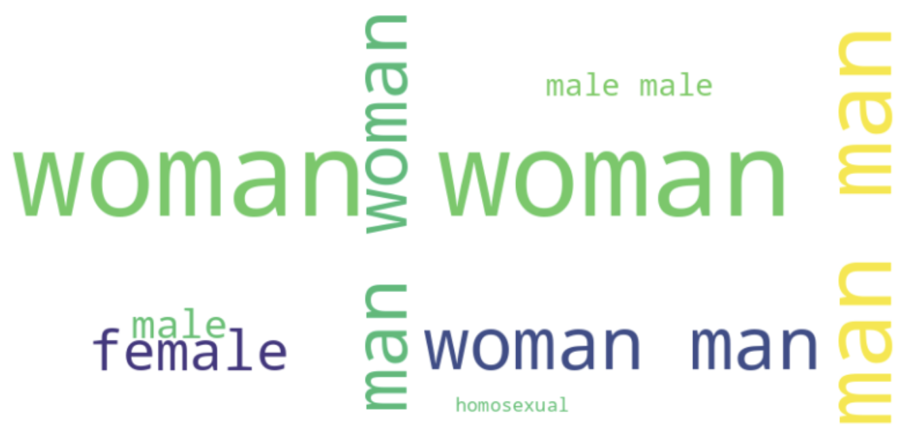
Word cloud for gender bias words
 | COMPANY 1 | COMPANY 2 | COMPANY 3 | COMPANY 4
JUPITER
SATURN
NEPTUNE

Slide 17
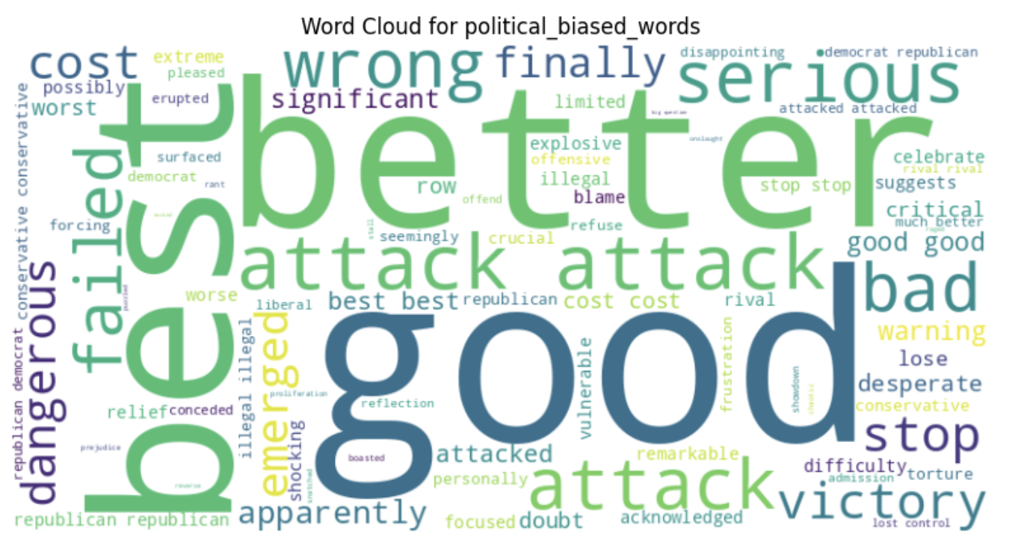
Word cloud for political bias words
 | COMPANY 1 | COMPANY 2 | COMPANY 3 | COMPANY 4
JUPITER
SATURN
NEPTUNE

Slide 18
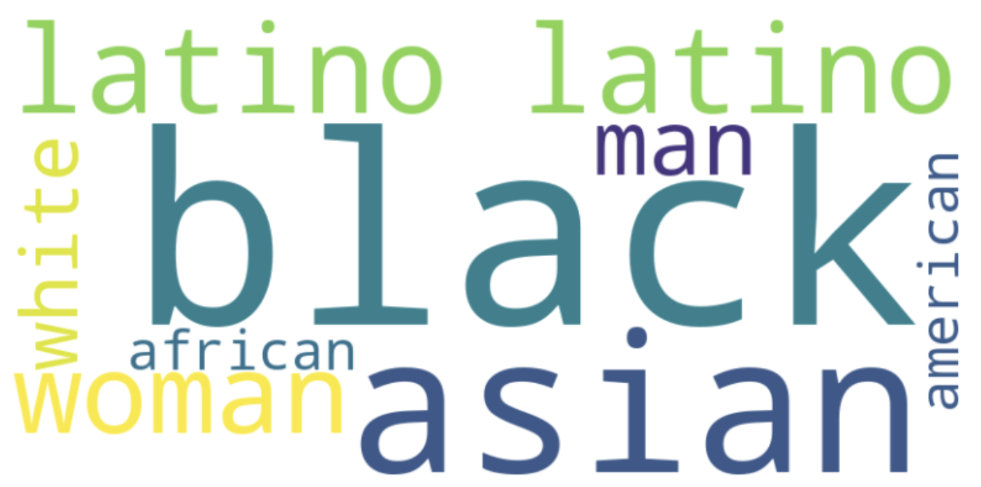
Word cloud for racial bias words
 | COMPANY 1 | COMPANY 2 | COMPANY 3 | COMPANY 4
JUPITER
SATURN
NEPTUNE

Slide 19
03.
Sentiment analysis
Negative - Neutral - Positive

Slide 20
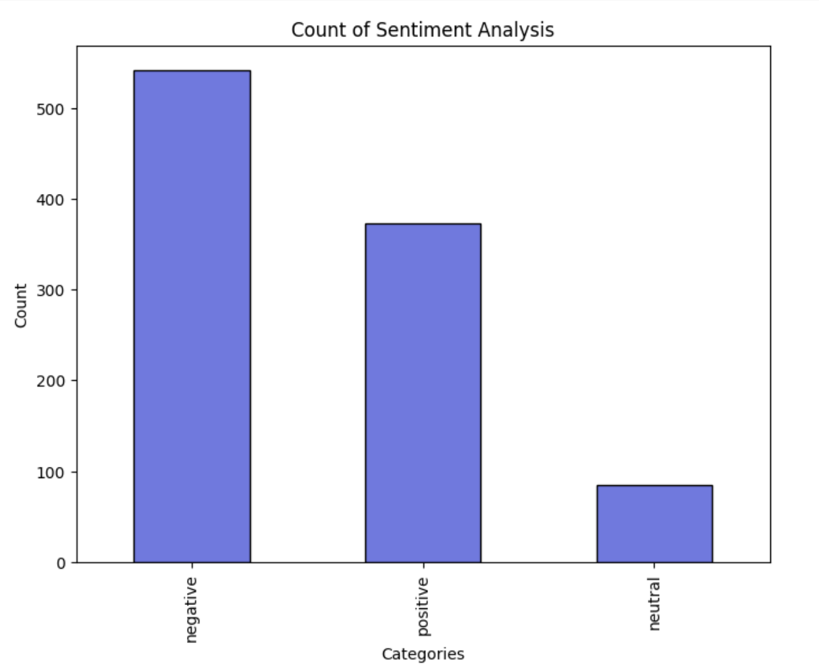
Models used
Vader Lexicon
Transformer (cardiffnlp/twitter-xlm-roberta-base-sentiment)

Slide 21
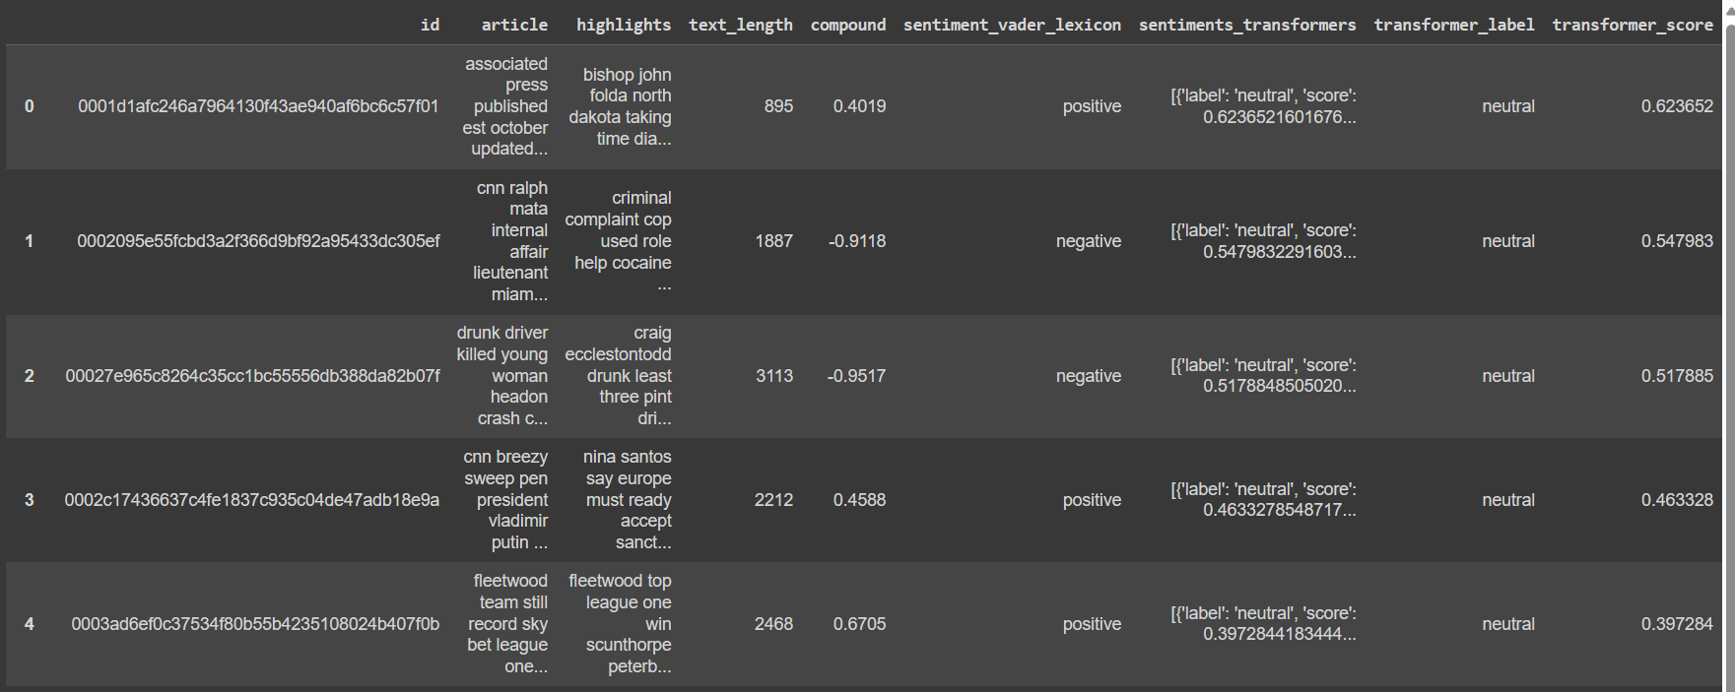
Sentiment analysis

Slide 22
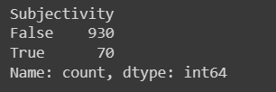
Subjectivity analysis
Suggesting an objective tone

Slide 23
04.
Emotions & sarcasm detection

Slide 24
Models used
Emotion Detection:
EmoRoBERTa
and bert-base-multilingual-uncased-sentiment

Slide 25
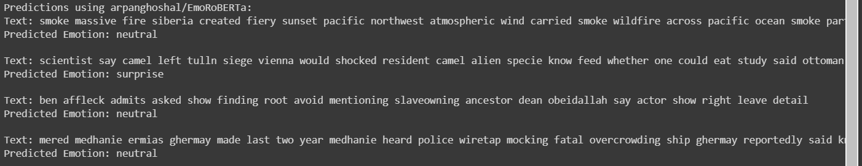
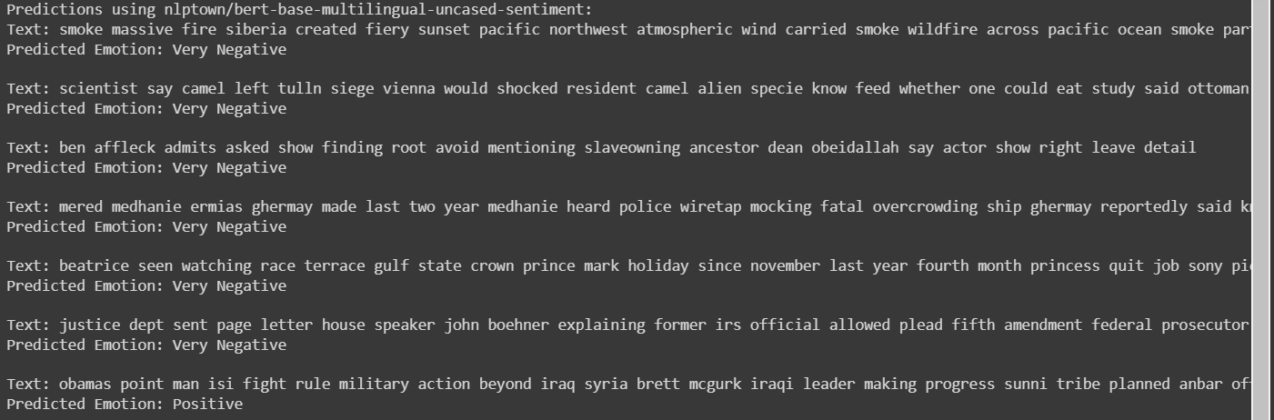
Emotion detection

Slide 26
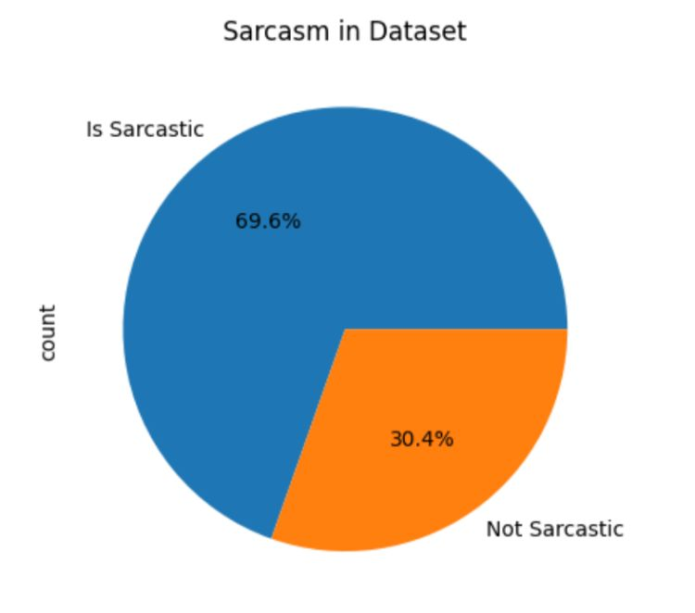
Sarcasm detection
Vectorization:
Word2Vec
GloVe
tf-idf

Slide 27
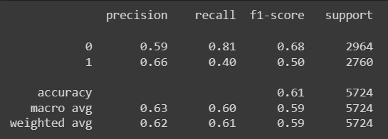
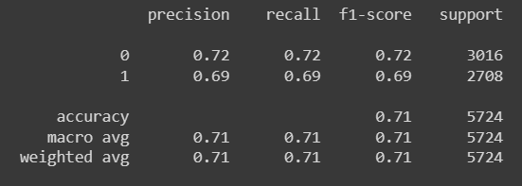
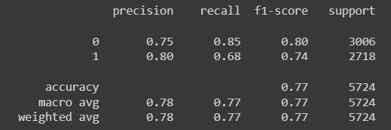
Sarcasm detection
Logistic Regression model:
SVC model:
Random Forest model:

Slide 28
05.
Media bias

Slide 29
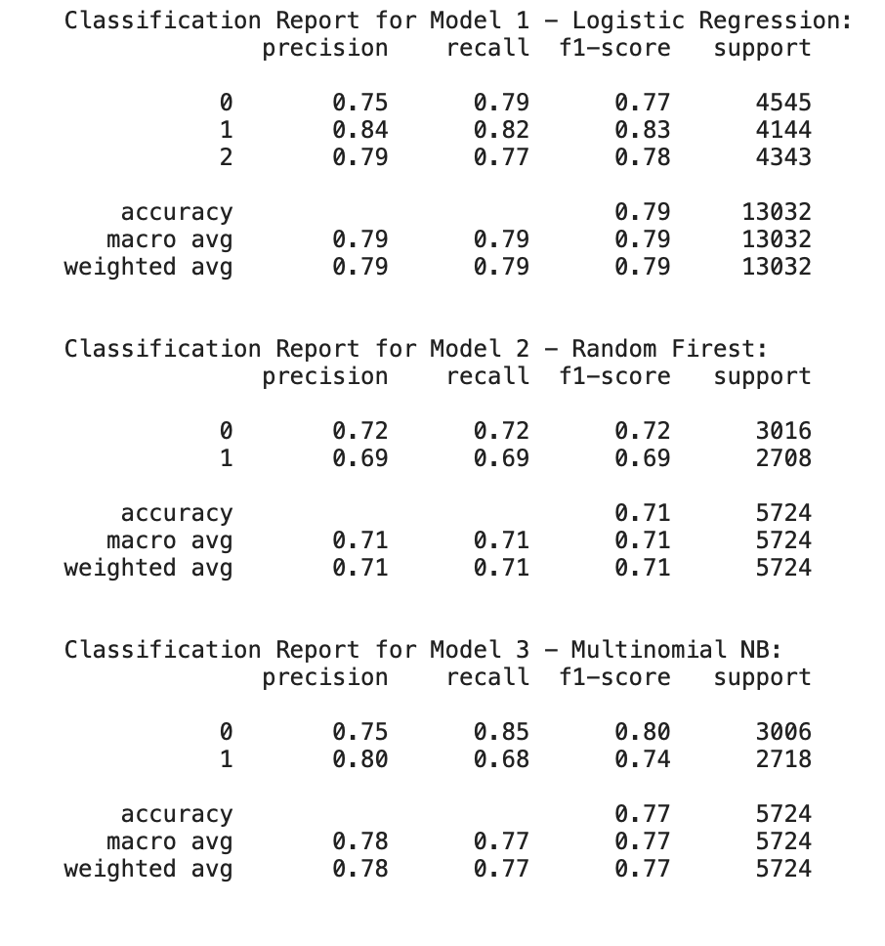
Classification report

Slide 30
06.
summarization
Abstractive and Extractive

Slide 31
T5
T5, short for Text-to-Text Transfer Transformer, operates on a transformer architecture that's specifically designed for text generation tasks. It functions by transforming input text into a target text based on a predefined task statement. T5 achieves this by training on vast amounts of data to understand how to convert one form of text into another.
The ROUGE scores, which measure the quality of text summarization by comparing generated summaries to reference summaries, indicate T5's performance. A higher ROUGE-1, ROUGE-2, and ROUGE-L F1 score signifies better performance. In this case:
ROUGE-1 F1 Score (T5): 0.3768115892123504
ROUGE-2 F1 Score (T5): 0.10526315289819968
ROUGE-L F1 Score (T5): 0.3478260819659736

Slide 32
Extractive Summarization USING BERT
"Extractive Summarization with BERT involves identifying the most relevant sentences or phrases from the source text to form a summary. BERT, a Bidirectional Encoder Representations from Transformers, employs a deep learning model trained on a large corpus of text. It identifies important segments by understanding the context and significance of each sentence within the text.
ROUGE-1 F1 Score (Extractive): 0.3768115892123504
ROUGE-2 F1 Score (Extractive): 0.10526315289819968
ROUGE-L F1 Score (Extractive): 0.3478260819659736

Slide 33
Langchain
Langchain is a summarization model that arranges text sequentially to create summaries. It analyzes the input text, then constructs summaries by linking phrases or sentences in a chain-like manner. Trained on extensive data, Langchain aims to generate coherent summaries but might face challenges in accurately reproducing sequences from the original text, as seen in its performance scores. Enhancements in understanding context could refine Langchain's summarization capabilities.
ROUGE-1 F1 Score (Langchain): 0.6666666616746667
ROUGE-2 F1 Score (Langchain): 0.5185185135253774
ROUGE-L F1 Score (Langchain): 0.6666666616746667

Slide 34
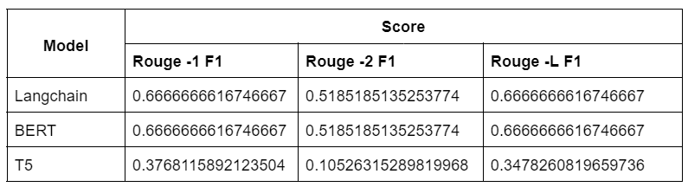
Comparing Scores

Slide 35
conclusion
Our study, 'Revealing Fairness in Summaries: Uncovering Bias in Text Summarization,' tackles bias issues in summarizing texts. We introduced an innovative method combining bias detection and controversial content identification in summarization, aiming for fairer, unbiased summaries. Using NLP and machine learning on CNN News articles and tweets, we found biases that could misrepresent, perpetuate inequality, and impact decision-making. We tested Langchain, T5, and BERT summarization models, evaluating their performance. Our research contributes to ethical NLP, building trust in automated summarization systems.

Slide 36
Future scope
Fairness & Bias:
Enhance algorithms to eliminate biases in summaries.
Integrate rules for fairness directly into the summarization process.
Multimedia Integration:
Combine diverse media (pictures, videos, spoken words) with written text in political summaries.
Create more comprehensive and balanced summaries.
Personalization:
Develop summaries tailored to individual preferences.
Adapt summaries based on user likes and opinions for a more personalized experience.

Slide 37
Implementation on a new article
Donald Trump has held very few consistent positions since he began running for president in 2015. The one that stands out? His relentless bashing of the media as “fake news” and insistence that Republicans tune out all forms of mainstream media.“It is amazing what’s happening to the discredited media like CNN, MSDNC, New York Times, and Washington Post,” Trump said in a statement released from his Save America PAC earlier this month. “Their businesses have dropped off a cliff, which is actually a very good thing for the American people, because they are Fake News (likewise the networks, ABC, NBC, CBS).”His six years in public life are littered with just that sort of over-the-top rhetoric, with few actual facts to back his wild claims up. No matter. A new Pew Research Center analysis shows that the number of Republicans who say they have “a lot” or “some” trust in national news organizations has been sliced in half over the last five years. In 2016, 70% of self-identified Republicans said they had at least some trust in national news organizations. That number is now 35%. And in 2020, trust in the national news media fell off a cliff. Almost half (49%) said they had a lot or some trust in the mainstream media in late 2019. That marks a 14-point drop on the question in less than two years.That precipitous decline is directly attributable to a nonstop – and largely one-way – attack on the idea of the media and, even more broadly, capital “T” truth. Remember that Trump told us exactly what he was up to back in 2018, speaking to a VFW gathering. “Don’t believe the crap you see from these people, the fake news,” Trump told the crowd. “What you’re seeing and what you’re reading is not what’s happening.” He wanted to be the sole disseminator of information – and “facts” – to his base. That desire was driven by selfish and political concerns: Trump wanted to create an alternate reality in which he was winning at everything from the economy to immigration to even Covid-19. That such a concerted effort would have disastrous and even deadly consequences – witness the number of unvaccinated Americans unnecessarily dying from Covid-19 – didn’t concern Trump. Vilifying the media, he believed, was a means to his desired end: winning reelection and/or burnishing his political (and personal) brand among the hardcore Trumpist base.

Slide 38
langchain
Summary:
{'text': 'Donald Trump has been attacking the media as "fake news" since 2015, leading to a decrease in trust in national news organizations among Republicans. His goal is to create an alternate reality in which he is winning, in order to win reelection and maintain his political brand.',
'sentiment_vader_lexicon': 'positive',
'transformer_label': 'neutral', 'transformer_score': 0.5971226096153259,
'polarity': 0.16,
'subjectivity': 0.45,
'emotion': 'Negative',
'sarcasm': 'Is Sarcastic',
'bias': 'Left'}

Slide 39
extractive
Summary:
{'text': 'Donald Trump has held very few consistent positions since he began running for president in 2015. In 2016, 70% of self-identified Republicans said they had at least some trust in national news organizations. That precipitous decline is directly attributable to a nonstop – and largely one-way – attack on the idea of the media and, even more broadly, capital “T” truth.',
'sentiment_vader_lexicon': 'positive',
'transformer_label': 'neutral', 'transformer_score': 0.4568938612937927,
'polarity': 0.08096938775510203,
'subjectivity': 0.3458673469387755,
'emotion': 'Very Negative',
'sarcasm': 'Is Sarcastic',
'bias': 'Left'}

Slide 40
THANK you

